Slide 1
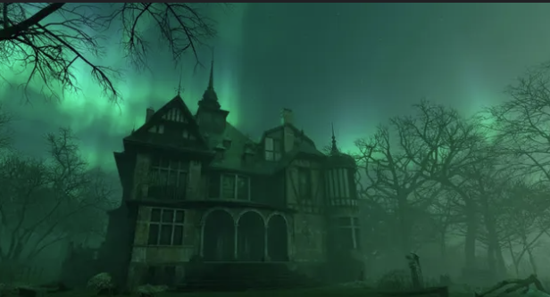
Haunted Places In The United States
Team Members:
Alejandro Alvarez
Sathvik
Dhru
Bobby
Brandon
Jhovanny

Slide 2
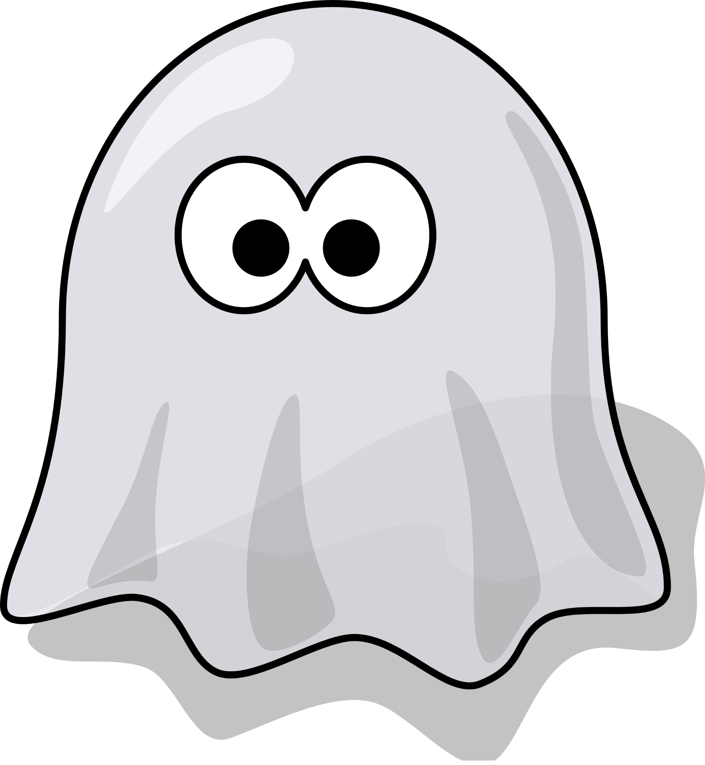
Research
Utilizing open-source tools and datasets sourced from Kaggle, our analysis revealed several compelling insights into haunted locations across the United States.
Identified Patterns and Trends: The data provided a wealth of information, allowing us to identify patterns and trends in reported haunted locations.
Highlighted Hotspots: We pinpointed key hotspots of paranormal activity, showcasing areas with the highest frequency of haunted place reports.
Visualization Techniques: Through rigorous data processing and advanced visualization techniques, we highlighted the most frequently reported haunted places, offering a fascinating glimpse into America's eerie and mysterious sites.

Slide 3

Open-source Tools
Kaggle
Jupyter Notebook
Google Colab

Slide 4
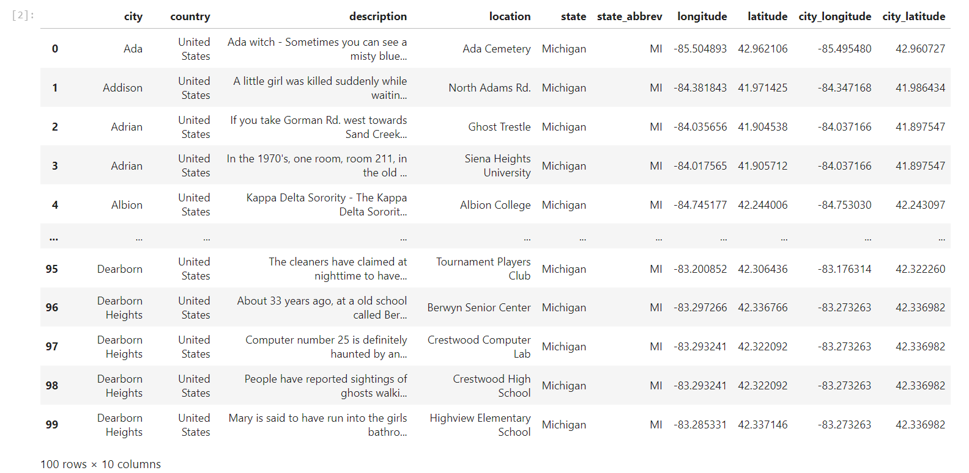
Data Description
Columns: 10
Rows: 5,000

Slide 5

Findings
Distribution of Sightings
The top 10 haunted states
The top 10 haunted Cities
The top 10 haunted Locations
The top 10 least haunted states
Most reported Words in the Description and Location
Weightage of Top Reported Locations in general

Slide 6
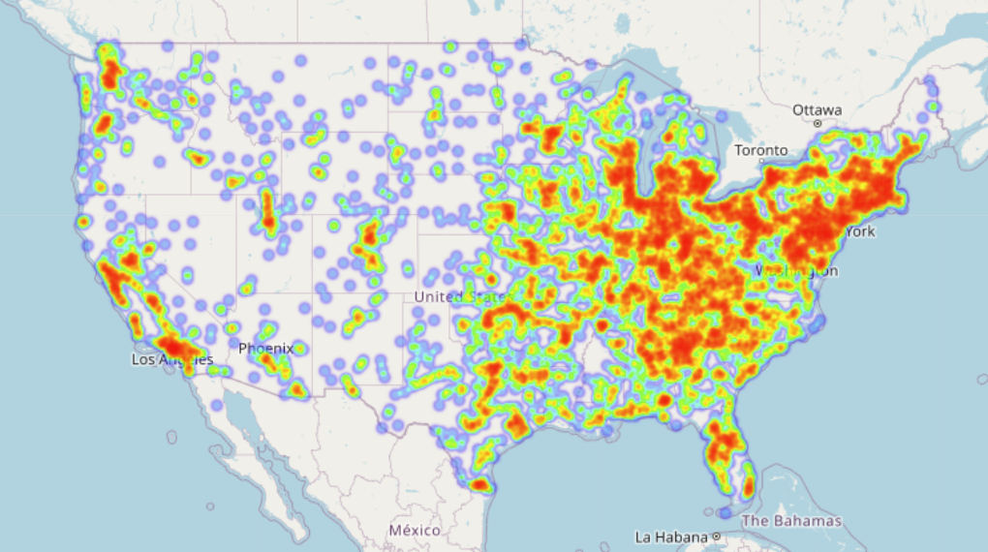
Reportings across USA : Heat Map

Slide 7
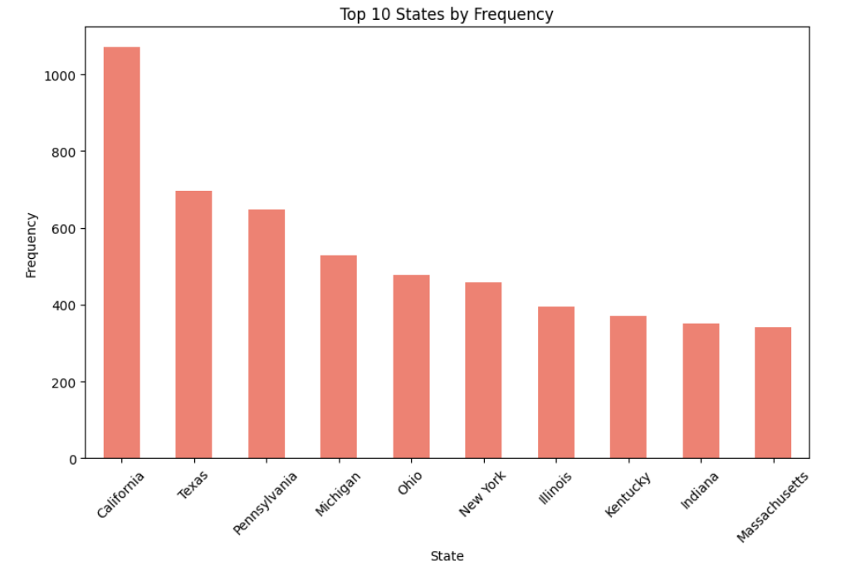
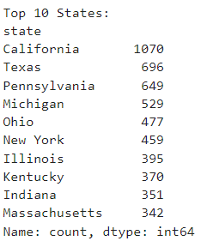
Top 10 Haunted States In The United States?

Slide 8
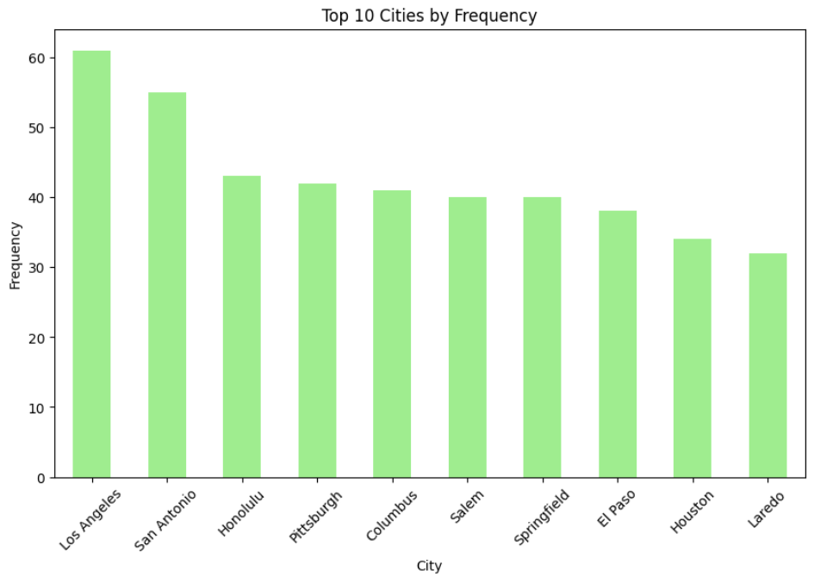
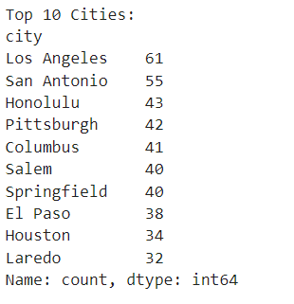
Top 10 Haunted Cities

Slide 9
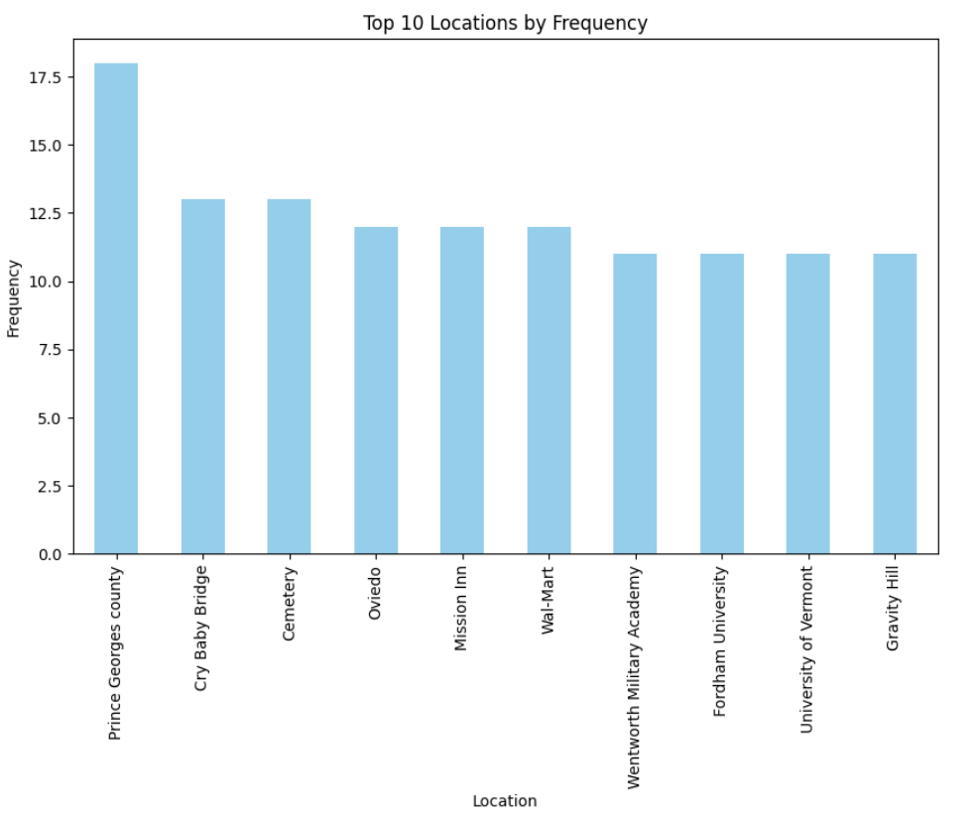
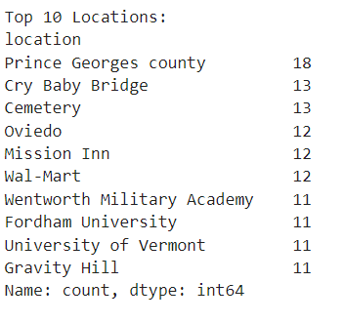
Top 10 Haunted Locations

Slide 10
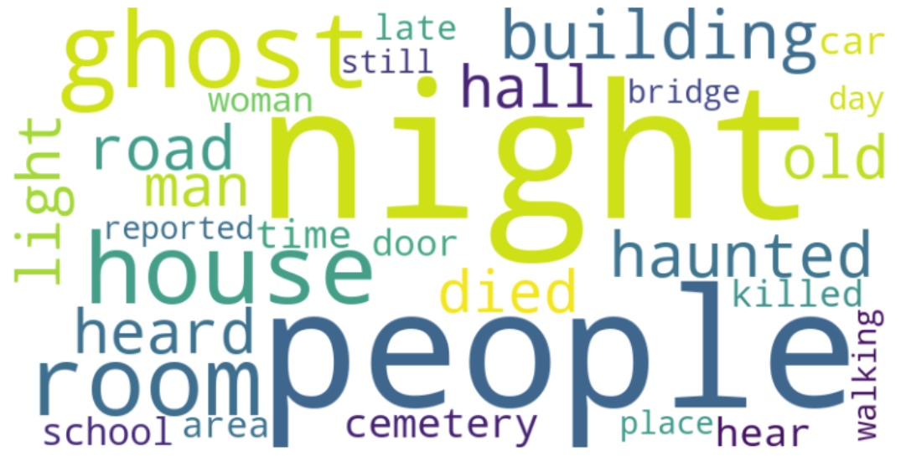
Most Used Words While Reporting

Slide 11
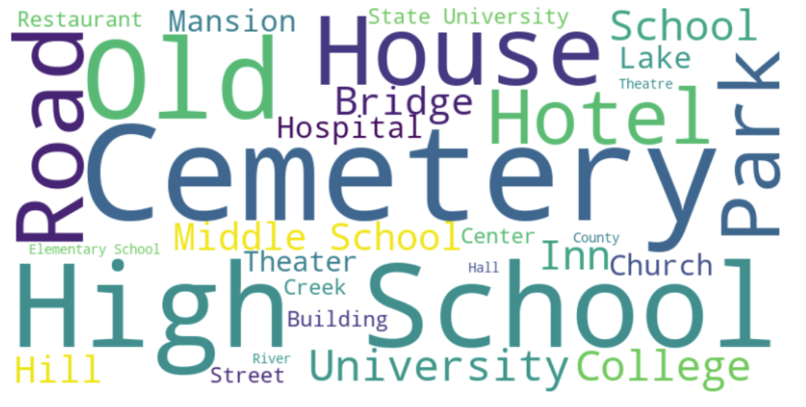
Most Reported Locations

Slide 12
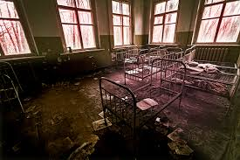
How Many Haunted Places Are Schools?
There are 1206 haunted schools in the United States. Haunted schools comprise 35.7% of the top 5 haunted locations in the United States taking the number 1# spot for most haunted sites.

Slide 13
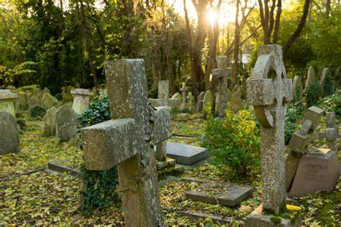
How Many Haunted Places Are Cemeteries?
According to the dataset, the cemetery comes in with 748 frequency which accumulates 22.1% of the top 5 reported places which makes it stand in the #2 most reported location in the USA.

Slide 14
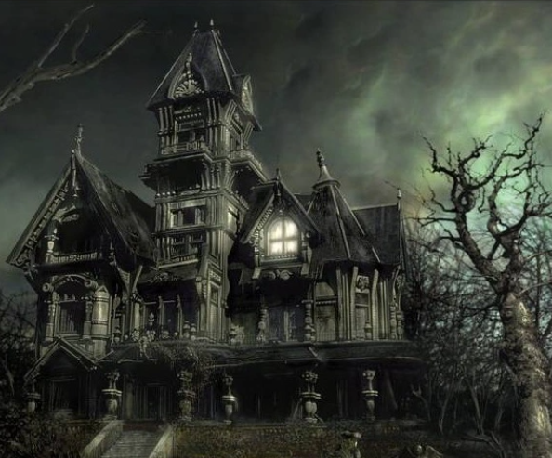
How Many Haunted Places Are Houses?
There are 498 haunted houses in the United States. Haunted Houses comprise 14.7% of the top 5 most haunted locations in the US, tied with universities for third in most haunted places.

Slide 15
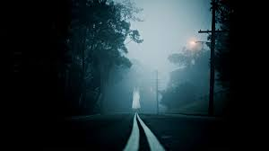
How Many Haunted Places Are Roads?
There are 135 haunted roads in the United States. Haunted roads comprise 12.8% of the most haunted locations in the United States and rank 5th making roads the least likely to be haunted.

Slide 16
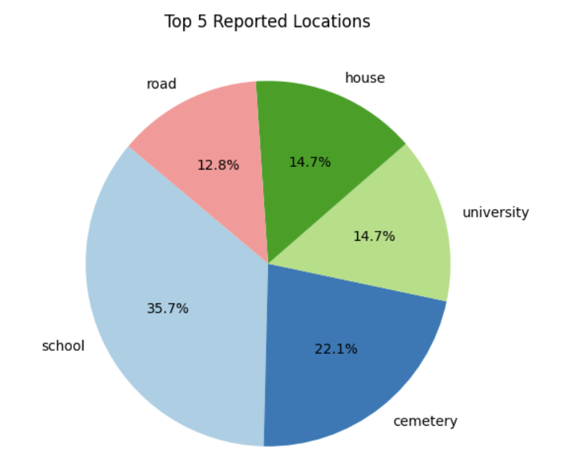
Most Reported Locations

Slide 17
Interesting Findings
Most Haunted State: California with 1070 sightings
Least Haunted State: Washington DC
Most Haunted City: Los Angeles with 61 sightings
Most Haunted Location: Prince George's County with 18 in a single place.
Most Reported word: Night - says that most of the reportings were during night.
Most Haunted Region: East to Midwest and some in West- says population played a key role.
Most Reported Location in general: School / Schools had 35.7% leading the Cemetery which had 22.1%.
NASA operated places were reported as haunted, which was surprising and obvious at the same time.

Slide 18
Thank You

